Slide 1
MIS 7720 Reinforcement Learning

Slide 2

What is Reinforcement Learning (RL) ?
A Machine Learning approach where an agent learns what actions to take given its state in an interactive environment to maximize some notion of (cumulative/delayed) reward via trial and error.

Slide 3
Formulating a RL problem
Environment: World in which the agent operates
State: Current situation of the agent
Reward: Feedback from the environment
Policy: Method to map agent’s state to actions
Value: Future reward that an agent would receive by taking an action in a particular state
RL is often modeled as a Markov Decision Process (MDP)
Notes:
Recall from earlier (#2_Intelligent Agents)

Slide 4
Markov Decision Process (MDP)
MDP provides a mathematical framework for modeling decision making in situations where outcomes are partly random and partly under the control of a decision maker.
set of finite environment states S,
set of possible actions A(s) in each state,
a real valued reward function R(s) and
a transition model P(s’|s, a)
Future states depend only on the present state (Markov property)
Problem: find a policy that specifies what action is taken in state S (mapping agent’s state to actions)
Goal: Optimal policy (or plan) = best actions
Notes:
https://en.wikipedia.org/wiki/Markov_decision_process

Slide 5
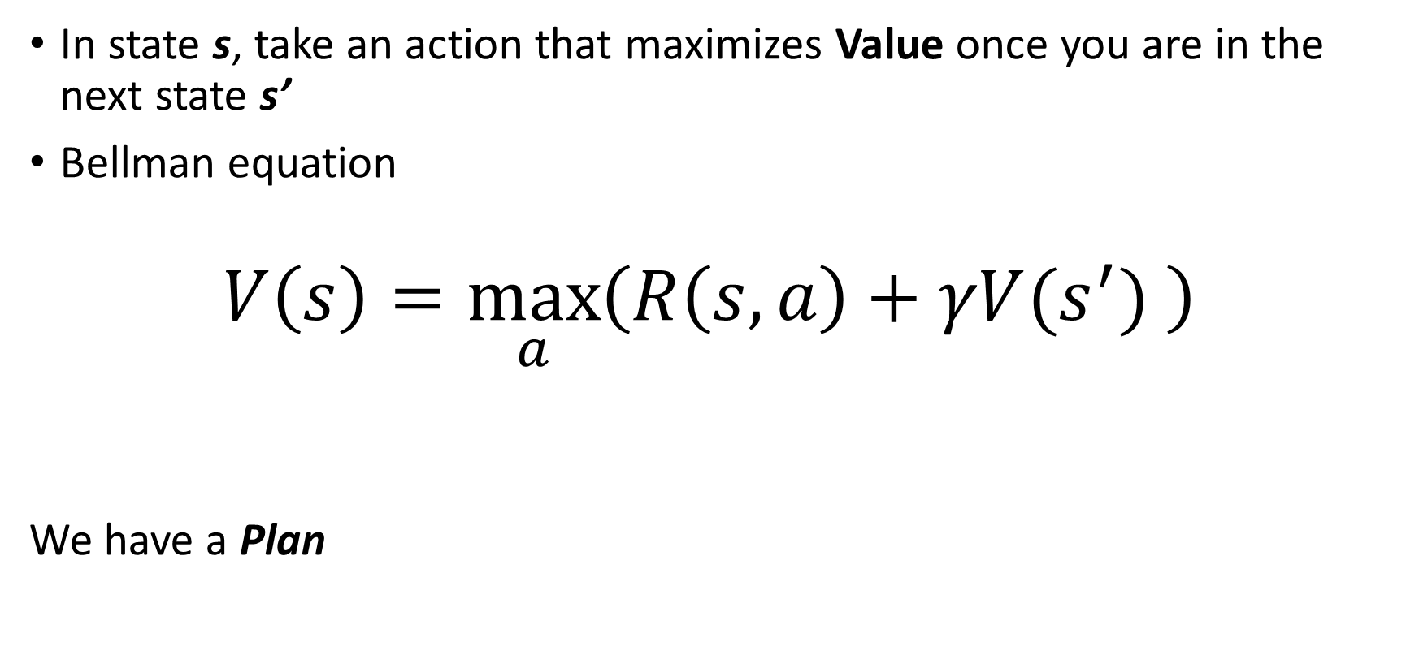
Deterministic environment
In state s, take an action that maximizes Value once you are in the next state s’
Bellman equation
$$V\left(s\right)=\max_{a}\left(R\left(s,a\right)+γV(s^{′}) \right)$$
We have a Plan
Reward from taking action a in state s
Value in new state
Discounting factor
Notes:
Explain using simple Maze example on board….

Slide 6
Simple Maze example: resulting Plan
Values in cells
Notes:
We only have a Reward at the terminal states. R(goal)=1, R(Fire)=-1

Slide 7

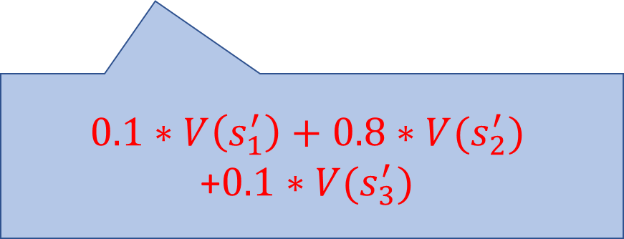
Non-deterministic environment
The next state s’ is not 100%, s’ can be one of multiple possible next states with some probability
$$V\left(s\right)=\max_{a}\left(R\left(s,a\right)+γV(s^{′}) \right)$$
$$0.1∗V\left(s_{1}^{′}\right)+0.8∗V(s_{2}^{′})$$
+$0.1∗V(s_{3}^{′})$
80%
10%
10%
Notes:
We can have positive/negative Rewards, R(s,a) at some/all states before the terminal/final states.

Slide 8
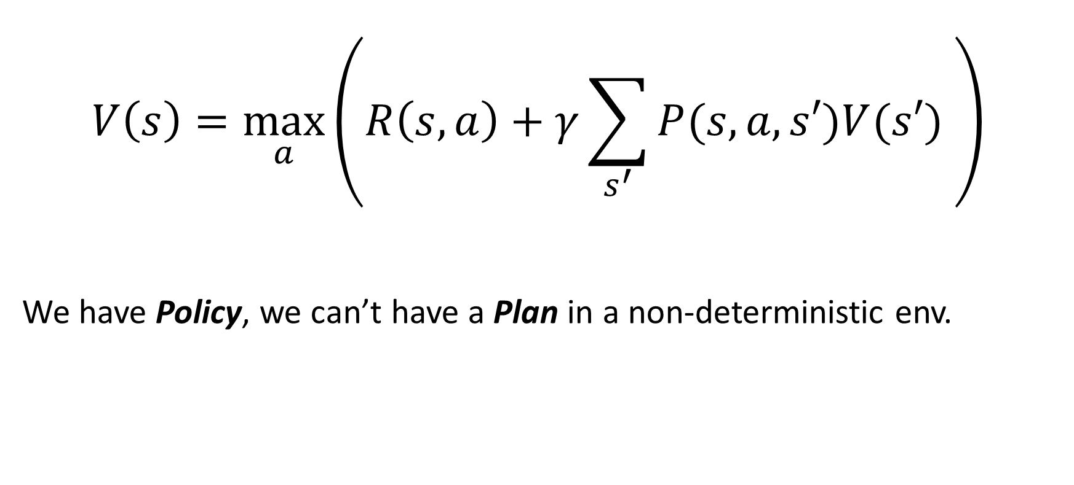
Non-deterministic environment
$$V\left(s\right)=\max_{a}\left(R\left(s,a\right)+γ\sum_{s^{′}}{P(s,a,s′)V(s′)} \right)$$
We have Policy, we can’t have a Plan in a non-deterministic env.
Expected value in new state
Notes:
We can have positive/negative Rewards, R(s,a) at some/all states before the terminal/final states.

Slide 9
Simple Maze example: Policy results
Values in cells

Slide 10
Model-free and Model-based
Model-based methods
Dynamic Programming (DP) – when we have a perfect model of the environment
Goal: optimal Plan
Model-free RL methods
When we don’t have reward functions and/or transition models (e.g., many real-world environments where we don’t have prior knowledge of environment dynamics)
Q-learning
Goal: optimal Policy

Slide 11
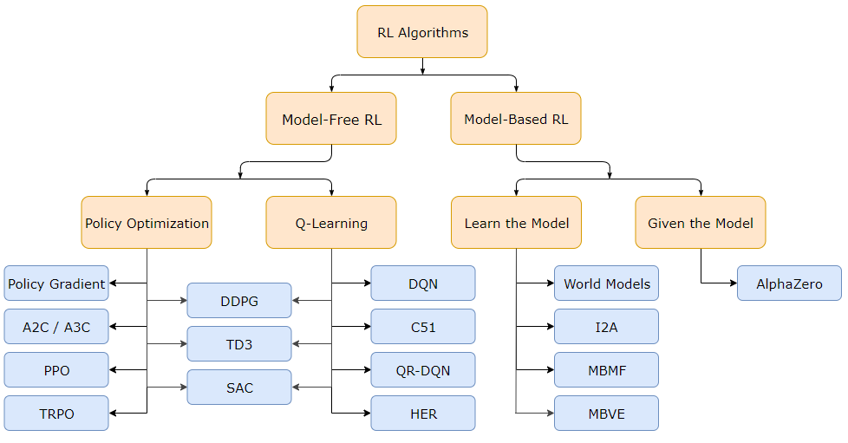
Overview of RL algorithms
Notes:
http://spinningup.openai.com/en/latest/spinningup/rl_intro2.html#a-taxonomy-of-rl-algorithms

Slide 12
Rat maze example
Top: a rat navigates a maze with distinctive goal boxes, each associated with a reward having the value shown.
Lower left: a model-free strategy relies on stored action values for all the state–action pairs obtained over many learning trials. To make decisions the rat just has to select at each state the action with the largest action value for that state.
Lower right: in a model-based strategy, the rat learns an environment model, consisting of knowledge of state-action-next-state transitions and a reward model consisting of knowledge of the reward associated with each distinctive goal box. The rat can decide which way to turn at each state by using the model to simulate sequences of action choices to find a path yielding the highest return.
Notes:
Ref: Figure 14.5 from Reinforcement Learning 2nd e, Richard Sutton & Andrew Barto

Slide 13
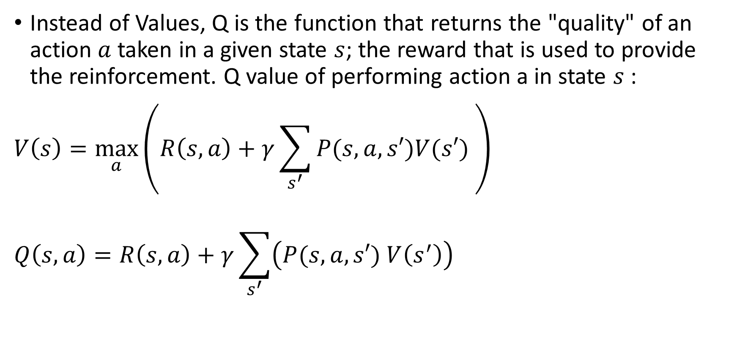
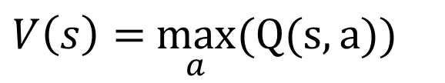
Q - learning
Instead of Values, Q is the function that returns the "quality" of an action $a$ taken in a given state $s$; the reward that is used to provide the reinforcement. Q value of performing action a in state $s$:
$$V\left(s\right)=\max_{a}\left(R\left(s,a\right)+γ\sum_{s^{′}}{P(s,a,s′)V(s′)} \right)$$
$$Q\left(s,a\right)=R\left(s,a\right)+γ\sum_{s^{′}}{\left(P(s,a,s′) V\left(s^{′}\right)\right) }$$
$V\left(s\right)=$ $\max_{a}(Q(s,a))$
Notes:
Goal: learn a policy that tells an agent what action to take under what circumstances.

Slide 14
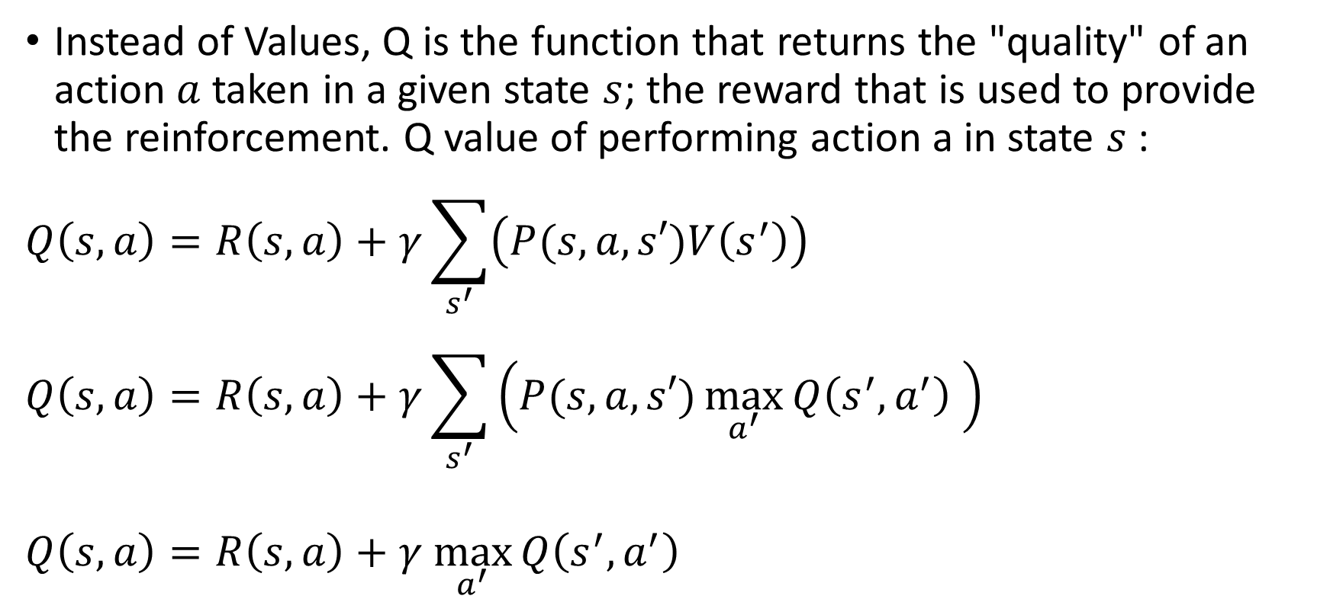

Q - learning
Instead of Values, Q is the function that returns the "quality" of an action $a$ taken in a given state $s$; the reward that is used to provide the reinforcement. Q value of performing action a in state $s$:
$$Q\left(s,a\right)=R\left(s,a\right)+γ\sum_{s^{′}}{\left(P(s,a,s′)V\left(s^{′}\right)\right) }$$
$$Q\left(s,a\right)=R\left(s,a\right)+γ\sum_{s^{′}}{\left(P(s,a,s′)\max_{a^{′}}{Q\left(s^{′},a^{′}\right)} \right)}$$
$$Q\left(s,a\right)=R\left(s,a\right)+γ \max_{a^{′}}{Q\left(s^{′},a^{′}\right)}$$
$$\max_{a^{′}}{Q\left(s^{′},a^{′}\right)}$$
Notes:
Goal: learn a policy that tells an agent what action to take under what circumstances.

Slide 15
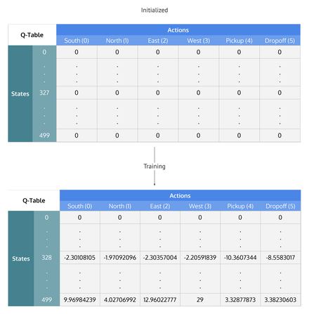
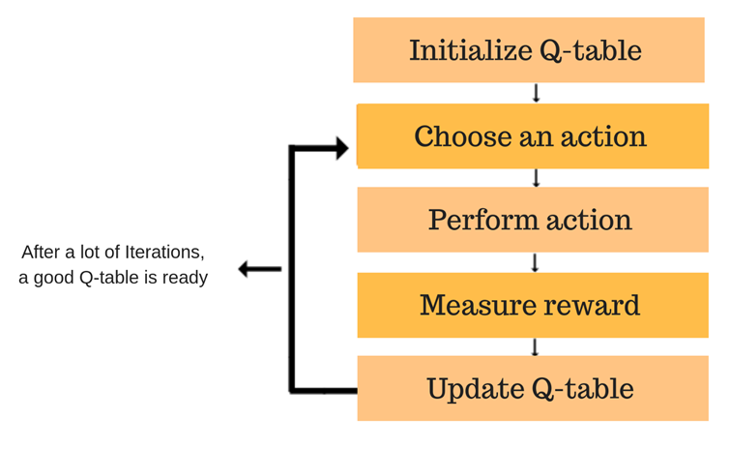
Q-learning overview

Slide 16
Temporal Difference – Motivation
"Suppose you wish to predict the weather for Saturday, and you have some model that predicts Saturday's weather, given the weather of each day in the week. In the standard case, you would wait until Saturday and then adjust all your models. However, when it is, for example, Friday, you should have a pretty good idea of what the weather would be on Saturday - and thus be able to change, say, Saturday's model before Saturday arrives.“
Suppose you are driving your car equipped with a GPS. At the start of your journey the GPS gives you an estimate of the arrival time (based on statistical data), as you drive and you hit traffic jams (or not), it refines its estimate and gives you other arrival times. You notice that at each portion of the trip you are provided with some estimate about the arrival time.
Now suppose that your GPS does not give you any estimate but stores the data until you arrive then gives you a detailed report on how much time each part of the road took. Would this be useful for you ?

Slide 17
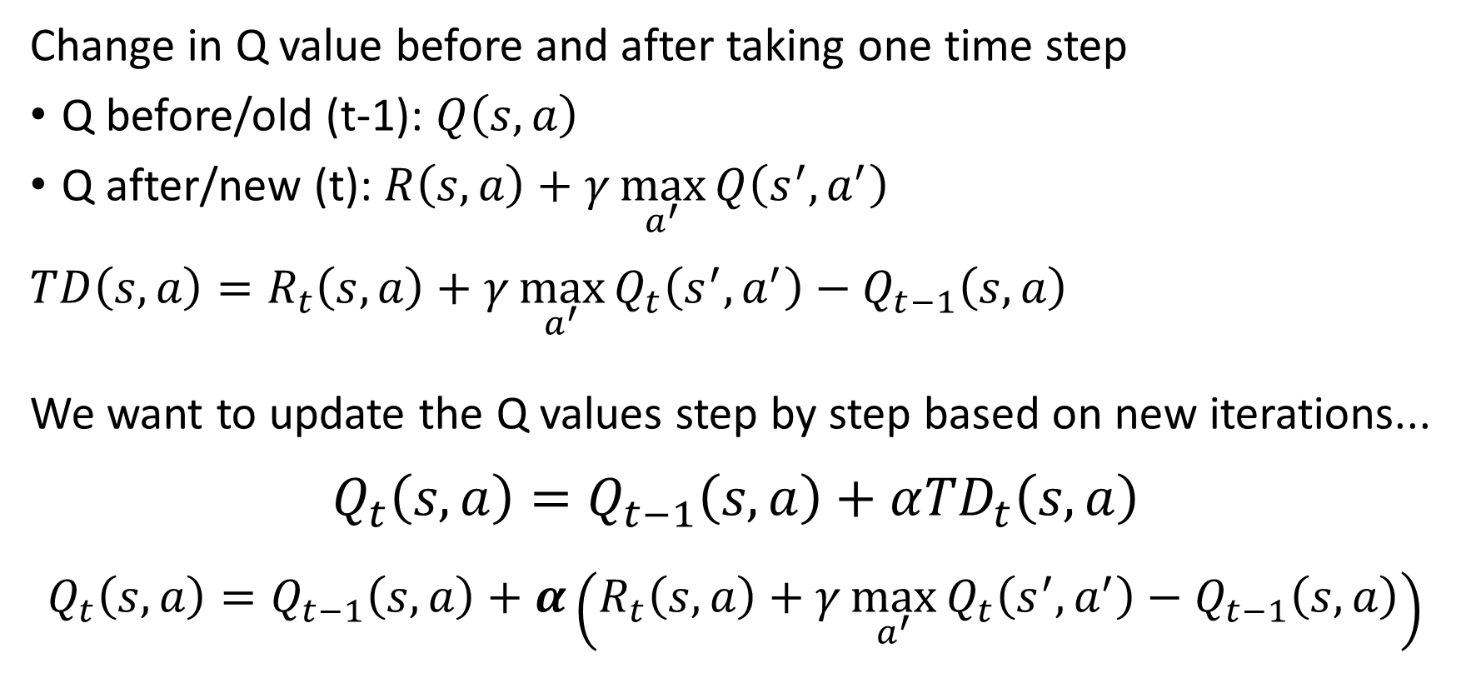
Temporal difference
Change in Q value before and after taking one time step
Q before/old (t-1): $Q\left(s,a\right)$
Q after/new (t): $R\left(s,a\right)+γ\max_{a^{′}}{Q\left(s^{′},a^{′}\right)}$
$$TD\left(s,a\right)=R_{t}\left(s,a\right)+γ\max_{a^{′}}{Q_{t}\left(s^{′},a^{′}\right)}−Q_{t−1}\left(s,a\right)$$
We want to update the Q values step by step based on new iterations...
$$Q_{t}\left(s,a\right)=Q_{t−1}\left(s,a\right)+α{TD}_{t}\left(s,a\right)$$
$$Q_{t}\left(s,a\right)=Q_{t−1}\left(s,a\right)+α\left(R_{t}\left(s,a\right)+γ\max_{a^{′}}{Q_{t}\left(s^{′},a^{′}\right)}−Q_{t−1}\left(s,a\right)\right)$$
Learning Rate
Notes:
Q values in a so called “Q table” are initialized to some arbitrary value (e.g., 0)
We could just ignore the old (before) value and consider the new(after) value.. BUT that would ignore random events that could be the result of the current Q. For example, what if our current observation is just an outcome that happens 10% of the time, we would have ignored what would happen 90% of the time.
Simulation: https://www.mladdict.com/q-learning-simulator

Slide 18
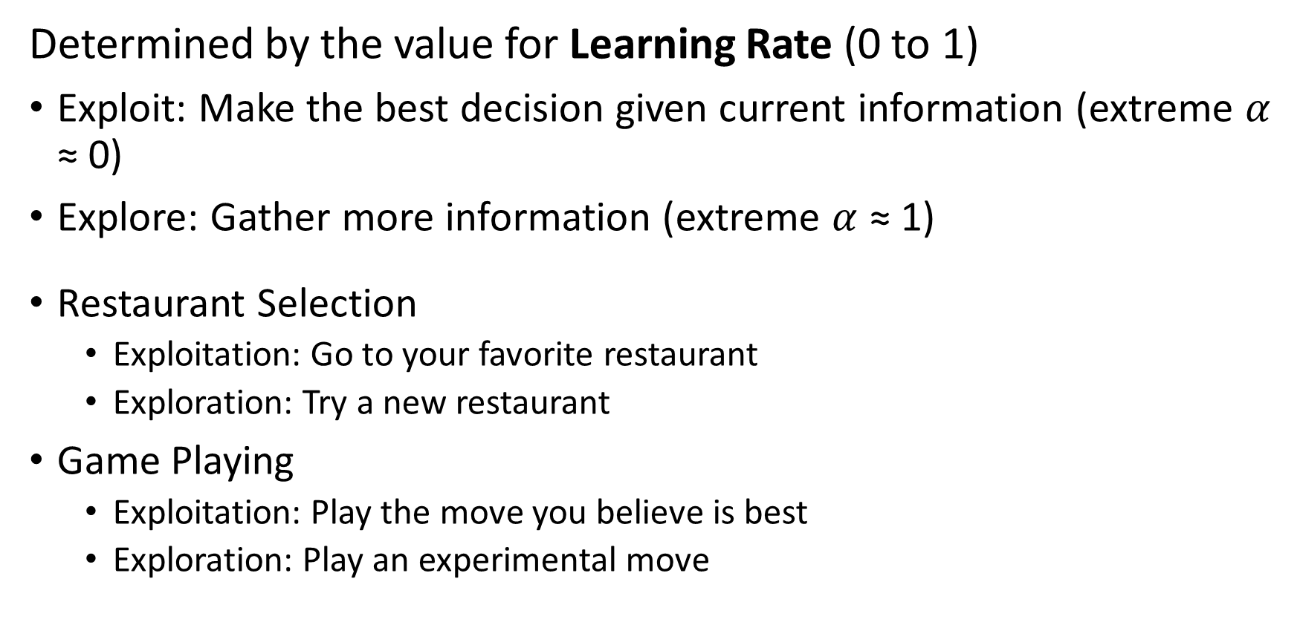
Exploration vs. Exploitation tradeoff
Determined by the value for Learning Rate (0 to 1)
Exploit: Make the best decision given current information (extreme $α$ ≈ 0)
Explore: Gather more information (extreme $α$ ≈ 1)
Restaurant Selection
Exploitation: Go to your favorite restaurant
Exploration: Try a new restaurant
Game Playing
Exploitation: Play the move you believe is best
Exploration: Play an experimental move
Notes:
Agent faces a dilemma between exploration and exploitation
Motivation:
The best long-term strategy may involve short-term sacrifices
Should I gather more information to make a potentially better decision in the future?

Slide 19
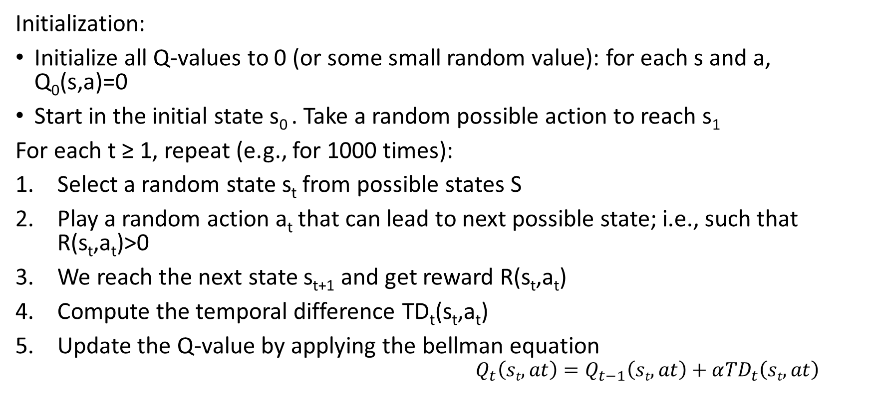
Q-learning algorithm
Initialization:
Initialize all Q-values to 0 (or some small random value): for each s and a, Q₀(s,a)=0
Start in the initial state s₀ . Take a random possible action to reach s₁
For each t ≥ 1, repeat (e.g., for 1000 times):
Select a random state s_{t} from possible states S
Play a random action a_{t} that can lead to next possible state; i.e., such that R(s_{t},a_{t})>0
We reach the next state s_{t+1} and get reward R(s_{t},a_{t})
Compute the temporal difference TD_{t}(s_{t},a_{t})
Update the Q-value by applying the bellman equation
$$Q_{t}\left(st,at\right)=Q_{t−1}\left(st,at\right)+α{TD}_{t}\left(st,at\right)$$
Notes:
Simulation: https://www.mladdict.com/q-learning-simulator

Slide 20
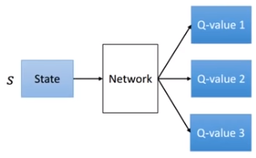
Deep Q-learning
The Q-table has Actions*States values that are iteratively updated
Size of the Q-table becomes impractically large in complex environments
Plus there are a lot of iterations
Adding NN to Q-learning
Instead of a Q-table, learn a compressed representation of it using NN
Use NN to approximate the Q-function
NN architecture for Deep Q-learning
Input is the state; no. input nodes=number of inputs
Output nodes: Q values for each possible action
Action 1
Action 2
Action 3
Notes:
Adding neural networks to Q-learning
Deep RL → adding NN to RL

Slide 21

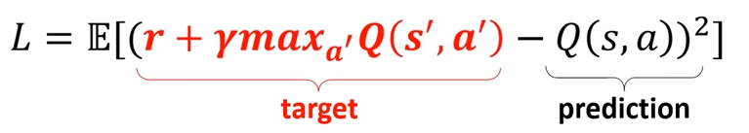
Deep Q-learning
Instead of the TD we have the following Loss function for the NN
This loss is backpropagated through the NN and weights updated to achieve smaller Loss; agent (now the NN) learns to take better actions.
Agent’s action?
Action Selection:
Softmax
ε greedy
SoftMax
0.1
0.7
0.2
Notes:
Action selection procedure relates to the exploitation-exploration dilemma we talked about earlier
Softmax: changes the Q values to probabilities so that they sum up to 1 → takes the highest Q value
Epsilon greedy: takes the highest Q (1-eps) percent of the time and takes one of the other actions at random epsilon percent of the time.

Slide 22
Experience Replay
Usually, the NN would forget previous states once it moves to new states.
Could bias the learning process when consecutive states are correlated
Instead, store the agent's experiences e_{t}=(s_{t},a_{t},r_{t},s_{t+1})
A batch is stored, e.g., 50 time periods
Use a random uniform sample from these experiences to learn
Also, allows the NN to learn from rare experiences and use it in future learning periods
More efficient use of previous experience, by learning with it multiple times. This is key when gaining real-world experience is costly.
Notes:
Illustrate on board using example of car driving along curvy road

Slide 23
Overview of RL algorithms
Notes:
http://spinningup.openai.com/en/latest/spinningup/rl_intro2.html#a-taxonomy-of-rl-algorithms

Slide 24
RL applications
Playing games!
https://storage.googleapis.com/deepmind-media/alphago/AlphaGoNaturePaper.pdf
https://deepmind.com/blog/alphago-zero-learning-scratch/
https://science.sciencemag.org/content/362/6419/1140
Traffic light control (http://web.eecs.utk.edu/~itamar/Papers/IET_ITS_2010.pdf)
Web system configuration (http://ranger.uta.edu/~jrao/papers/ICDCS09.pdf)
Personalized recommendations (http://www.personal.psu.edu/~gjz5038/paper/www2018_reinforceRec/www2018_reinforceRec.pdf)
Bidding and advertising (https://arxiv.org/pdf/1802.09756.pdf)
https://deepmind.com/blog/deepmind-ai-reduces-google-data-centre-cooling-bill-40/

Slide 25
When should you (not) use RL?
RL is appropriate when problem has the following characteristics¹:
It is a sequential decision making task
There is some notion of (delayed) reward
How you define Reward matters (a lot!)
Learning by trail & error via interactive interaction with the environment
A simulated environment for the problem environment exists
Can be formulated as a Markov Decision Process (states, actions, reward function) – state transition probabilities can be missing
Notes:
¹ this list is probably not complete!
https://en.wikipedia.org/wiki/Sequential_decision_making

Slide 26
Deep RL pitfalls
Sample inefficient: model-free RL requires a lot of samples/data
Model-based RL is sample efficient; e.g., Atlas robot and AlphaGo use model-based RL
Defining the right Reward function is very difficult in practice
It has to capture exactly what you want
You may fall into local optima (even with the right Reward function)
There are tricks to help with this – not always guaranteed

Slide 27
More Resources
RL with tensorflow
https://medium.com/emergent-future/simple-reinforcement-learning-with-tensorflow-part-0-q-learning-with-tables-and-neural-networks-d195264329d0
Reinforcement Learning an introduction, 2nd edition, Richard Sutton & Andrew Barto (2018)
https://mitpress.mit.edu/books/reinforcement-learning-second-edition
http://rail.eecs.berkeley.edu/deeprlcourse/
An intro to Deep RL https://arxiv.org/abs/1811.12560

